Slide 1
This is a power point presentation of a lecture I gave on 20th May to the Microbiology group in Biological Sciences, University of Southampton
The lecture summarised my 40 years of work on methylotroph metabolism in 40 minutes.
I have added a few extra slides to make the stories complete.

Slide 2
Methylotroph stories
Dedicated to research students everywhere
My CV
Born Watford in 1939, son of a brewery labourer.
1950 – 1957 Watford Grammar School
1957 – 1960 Reading University BSc Microbiology
1960 – 1963 Reading University PhD Thesis: The microbial metabolism of one-carbon compounds
1963 – 1966 Reading University Post Doc: A novel methanol dehydrogenase
1966 - 1967 Sheffield University Post Doc: glutamate fermentation in Clostridia
1967 – 2004 Southampton University: Lecturer etc
2005 ­– present time: Southampton University: Emeritus Professor

Slide 3
Thank you to my research students (1969 – 2008)
Methanol dehydrogenase | Cytochromes and electron transport | Metabolic pathways | 3D structures
Steven Ford Dudley Page Darren Day Jonathan Cox Ian Richardson Alain Avezoux Karen Amaratunga Tosin Majekodunmi Paul Afolabi | Jim Elliott Steven Froud David O’Keefe Andrew Cross Mathew Beardmore-Gray Anthony Long Claude Chan Helen Ashworth | Pat Dunstan Iain Taylor John Bolbot | Peter James Paul Williams Gyles Cozier Simon Dales [John Read] [Chenyi] [Leigh Felton]
 | Also Bill Keevil (Post-doc); Paul Skipp (Technician) | Also Bill Keevil (Post-doc) Paul skipp (Technician)
Amino acid transport | Electron transport and nitrogen fixation | Neomycin biosynthesis | Electron transport in methylamine metabolism
Jeff Robinson Bob Cook | Andrew Smith Nick Juty | Cedric Pearce | Ashley Lawton Kevin Auton

Slide 4
Methylotroph stories
Methylotrophs are bacteria that grow with compounds with a single carbon atom as their sole source of carbon and energy. ‘Ordinary bacteria’ never grow methylotrophically.
The rise of the methylotrophs. Only 2 species in 1960. Many hundreds now – with enormous genetic and metabolic diversity.
2. Methanol dehydrogenase (MDH); the first Quinoprotein.
3. A special electron transport chain for methanol oxidation.
4. A remarkable resurgence of interest in MDH.
My PhD project (1960 – 1963): Isolate a bacterium able to grow on methanol and therefore able to oxidise it. Then find the enzyme responsible.

Slide 5
1. The rise of the methylotrophs.
Always specialised genera; never the usual types of bacteria
Many grow well on ‘ordinary’ substrates – succinate, lactate etc
Only 2 species in 1960. Only 4 papers in my PhD introduction
Many hundreds of species now – with enormous genetic diversity
A wealth of novel metabolic pathways for conversion of formaldehyde to cell material
Unusual energy transduction
Regular international symposia (from 1970 to present day)
Industrial exploitation. This is because of their metabolic diversity and because their growth substrate, methanol, is inexpensive

Slide 6
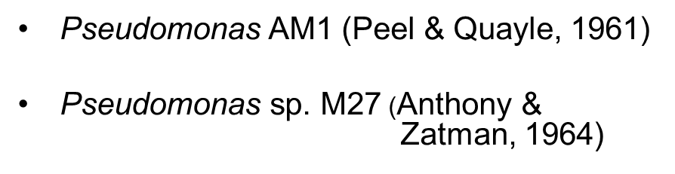
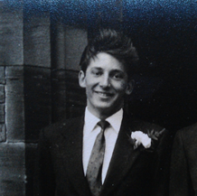
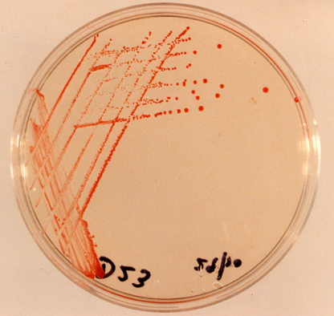
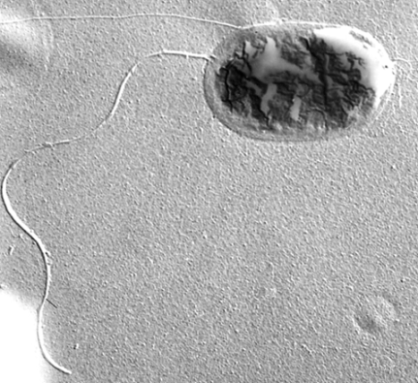
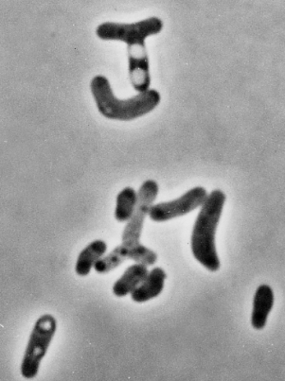
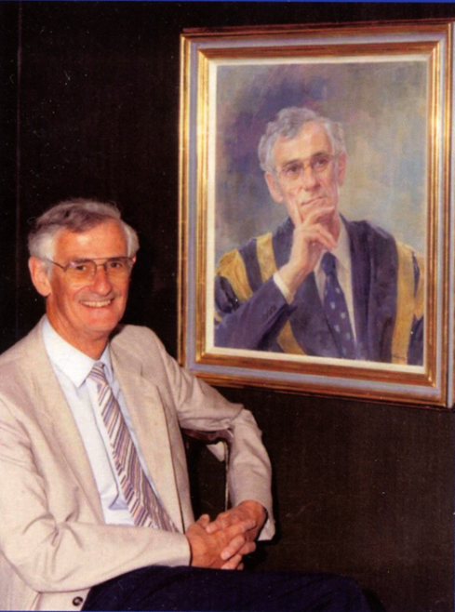
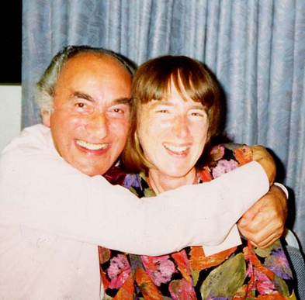
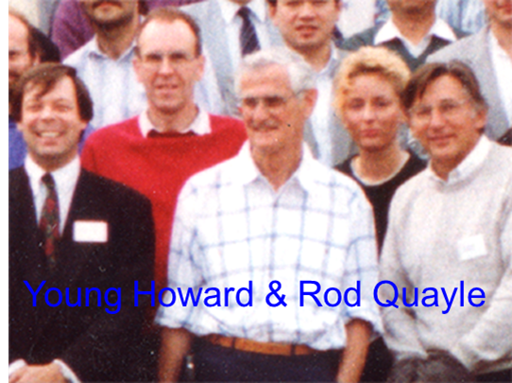
The main ‘workhorses’ in the study of methylotrophs
Methylobacterium extorquens. A pink facultative methylotroph
Me in 1963
J Rod Quayle
My PhD supervisor and my first research student (Len Zatman and Pat Dunstan, now Goodwin)
Howard Dalton, Rod and me

Slide 7
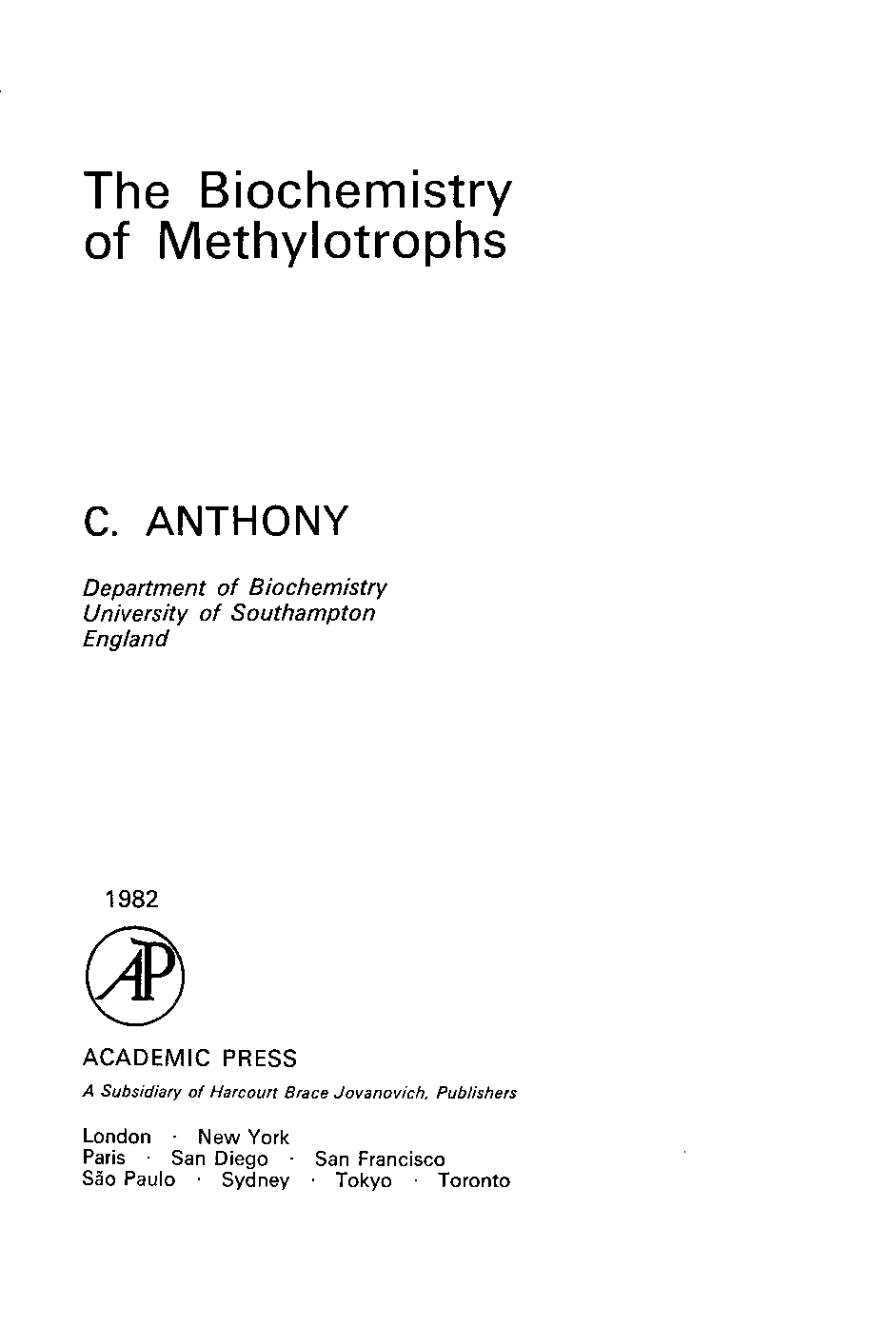
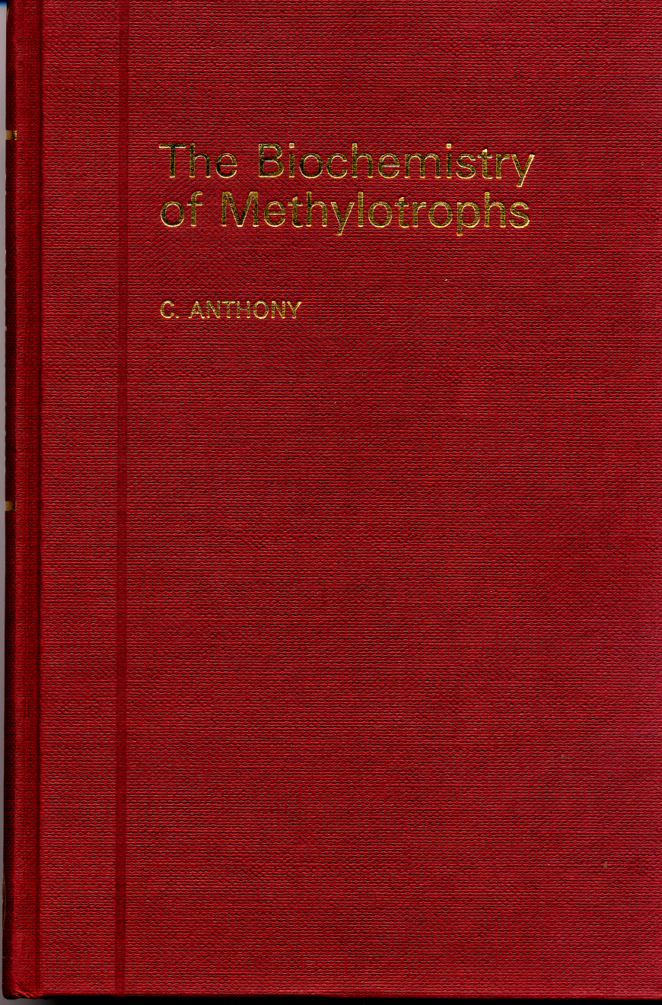
The Biochemistry of Methylotrophs 1982
Methylotrophic bacteria
Ribulose bisphosphate pathway
Ribulose monophosphate cycle
The Serine pathway
The TCA cycle and growth
on multicarbon compounds
Oxidation of methane, methanol,
formaldehyde and formate
Oxidation of methylated amines
Electron transport and
energy transduction
Growth yields and bioenergetics
Methylotrophic yeasts
Methanogens and
methanogenesis
Commercial exploitation
Chapters 12
Text pages 350
Index 48 pages
Tables 60
Figures 57
References 1300
A CD version is available and the complete book
is on my website: chris-anthony.co.uk

Slide 8
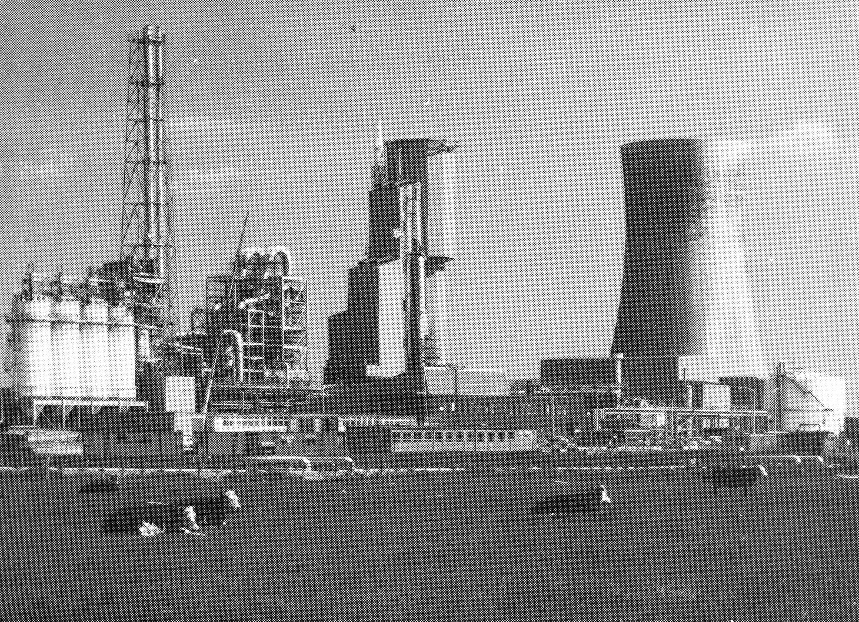
The ICI ‘Pruteen’ plant at Billingham, UK 1980
For production of protein supplement for cattle feed
The centre tower is the 1.5 million litre fermenter
It contains about 100,000,000,000,000,000,000 methylotrophs
10% of their soluble protein is Methanol dehydrogenase

Slide 9
2nd Story: Methanol dehydrogenase
An enzyme with a remarkable structure and novel type of prosthetic group - PQQ (the first Quinoprotein). The false claim that PQQ is a new vitamin
Oxidising enzymes.
Most common: alcohol + NAD+ aldehyde + NAD + H+
Alternative oxidising enzymes are membrane bound and have FAD or FMN as a bound prosthetic group: succinate + Enz-FAD fumarate + Enz-FADH2
Most living things have an NAD-linked alcohol dehydrogenase
BUT none oxidises methanol so my supervisor, Len Zatman, thought there might be an interesting dehydrogenase in bacteria able to oxidise methanol to formaldehyde.
My project: Isolate a bacterium able to grow on methanol and therefore able to oxidise it. Then find the enzyme responsible.
I thought this was a trivial problem but it was not.
My first paper was on a novel methanol dehydrogenase (1964)
My last paper was on the very high (atomic) resolution of this enzyme (2004)

Slide 10
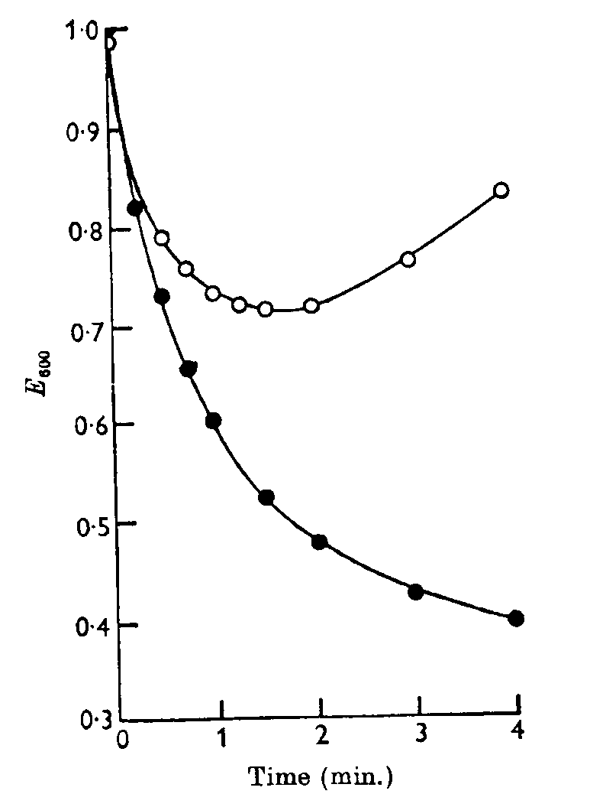
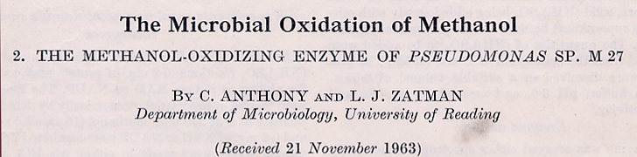
Methanol dehydrogenase
Responsible for all bacterial methanol oxidation
A soluble enzyme – now known to be in the periplasm
Dye-linked assay (PMS/PIP); pH optimum 9.2; pI 8.2
Methanol + PMS Formaldehyde + PMSH₂
PMSH₂ is oxidised by blue PIP which loses it colour
Activator is ammonia (not NH₄+ ion) (this is unique)
Wide substrate specificity
Unusual absorption spectrum – not FAD or FMN so novel prosthetic group??
High proportion of tryptophans
MDH assay
with PMS/indophenol

Slide 11
Isolation of the prosthetic group
The prosthetic group is the part of the enzyme that is not the amino acid chain.
It is FAD or FMN in flavoproteins, or haem in cytochromes
Grow huge amounts of bacteria on methanol. Harvest and break (ultrasound)
Purify the enzyme from the soluble fraction (Ion exchange, Sephadex etc)
Precipitate the protein and release the fluorescent prosthetic group by acid treatment
Purify the prosthetic group (ion exchange etc). After 3 months I had a few red grains.
Characterised by its excitation and emission fluorescence. A beautiful green colour.
The only known compound with a maximum excitation at 360nm with this maximum occurring at low pH. It is tightly bound to the enzyme.
SO a completely new compound. Thirteen years later its structure was determined by X-ray crystallogaphy at Cambridge; then confirmed by us a further 15 years later with the X-ray structure of the whole enzyme.

Slide 12
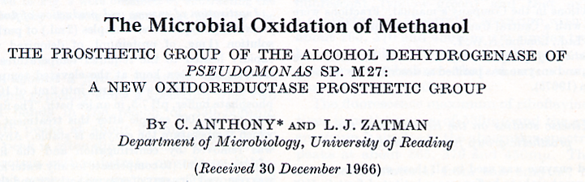
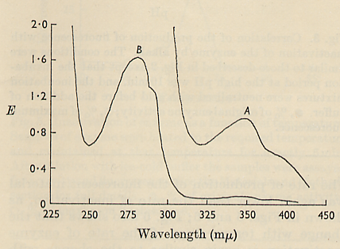
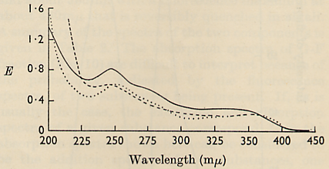
A new type of enzyme prosthetic group
Note: all other dehydrogenases use NAD(P) as hydrogen acceptor or they are membrane flavoproteins that use FMN or FAD as prosthetic group
Spectrum of MDH
Spectrum of prosthetic group

Slide 13
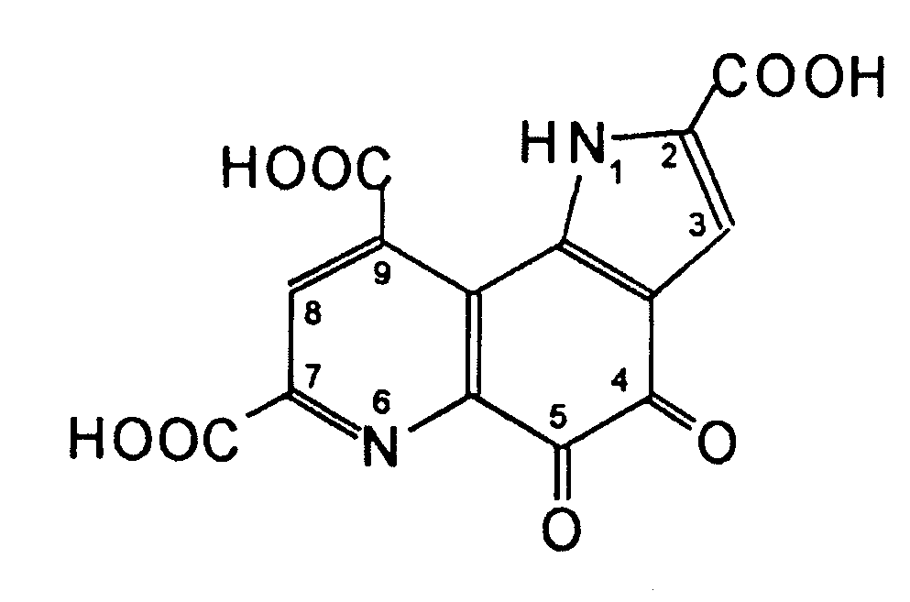
PQQ and Quinoproteins
Pyrroloquinoline Quinone PQQ)
PQQ-containing Quinoproteins
All bacterial dehydrogenases
Usually responsible for 1st step in the oxidation of growth substrate
Mainly alcohols and aldoses
eg ethanol oxidation to acetic acid in acetic acid bacteria
Reaction occurs in the periplasm
Electron acceptors are cytochromes, blue copper proteins or ubiquinone
May be soluble or membrane-bound
May also have contain haem
None has been described in eukaryotic organisms
Ca
First isolated and purified by Anthony & Zatman in1967 from bacterial methanol dehydrogenase
Structure determined by
Kennard’s group in1979
Remains tightly bound throughout reaction cycle

Slide 14
From 1988 onwards there have been International Symposia on PQQ and Quinoproteins The 5th was in Southampton in 2002

Slide 15
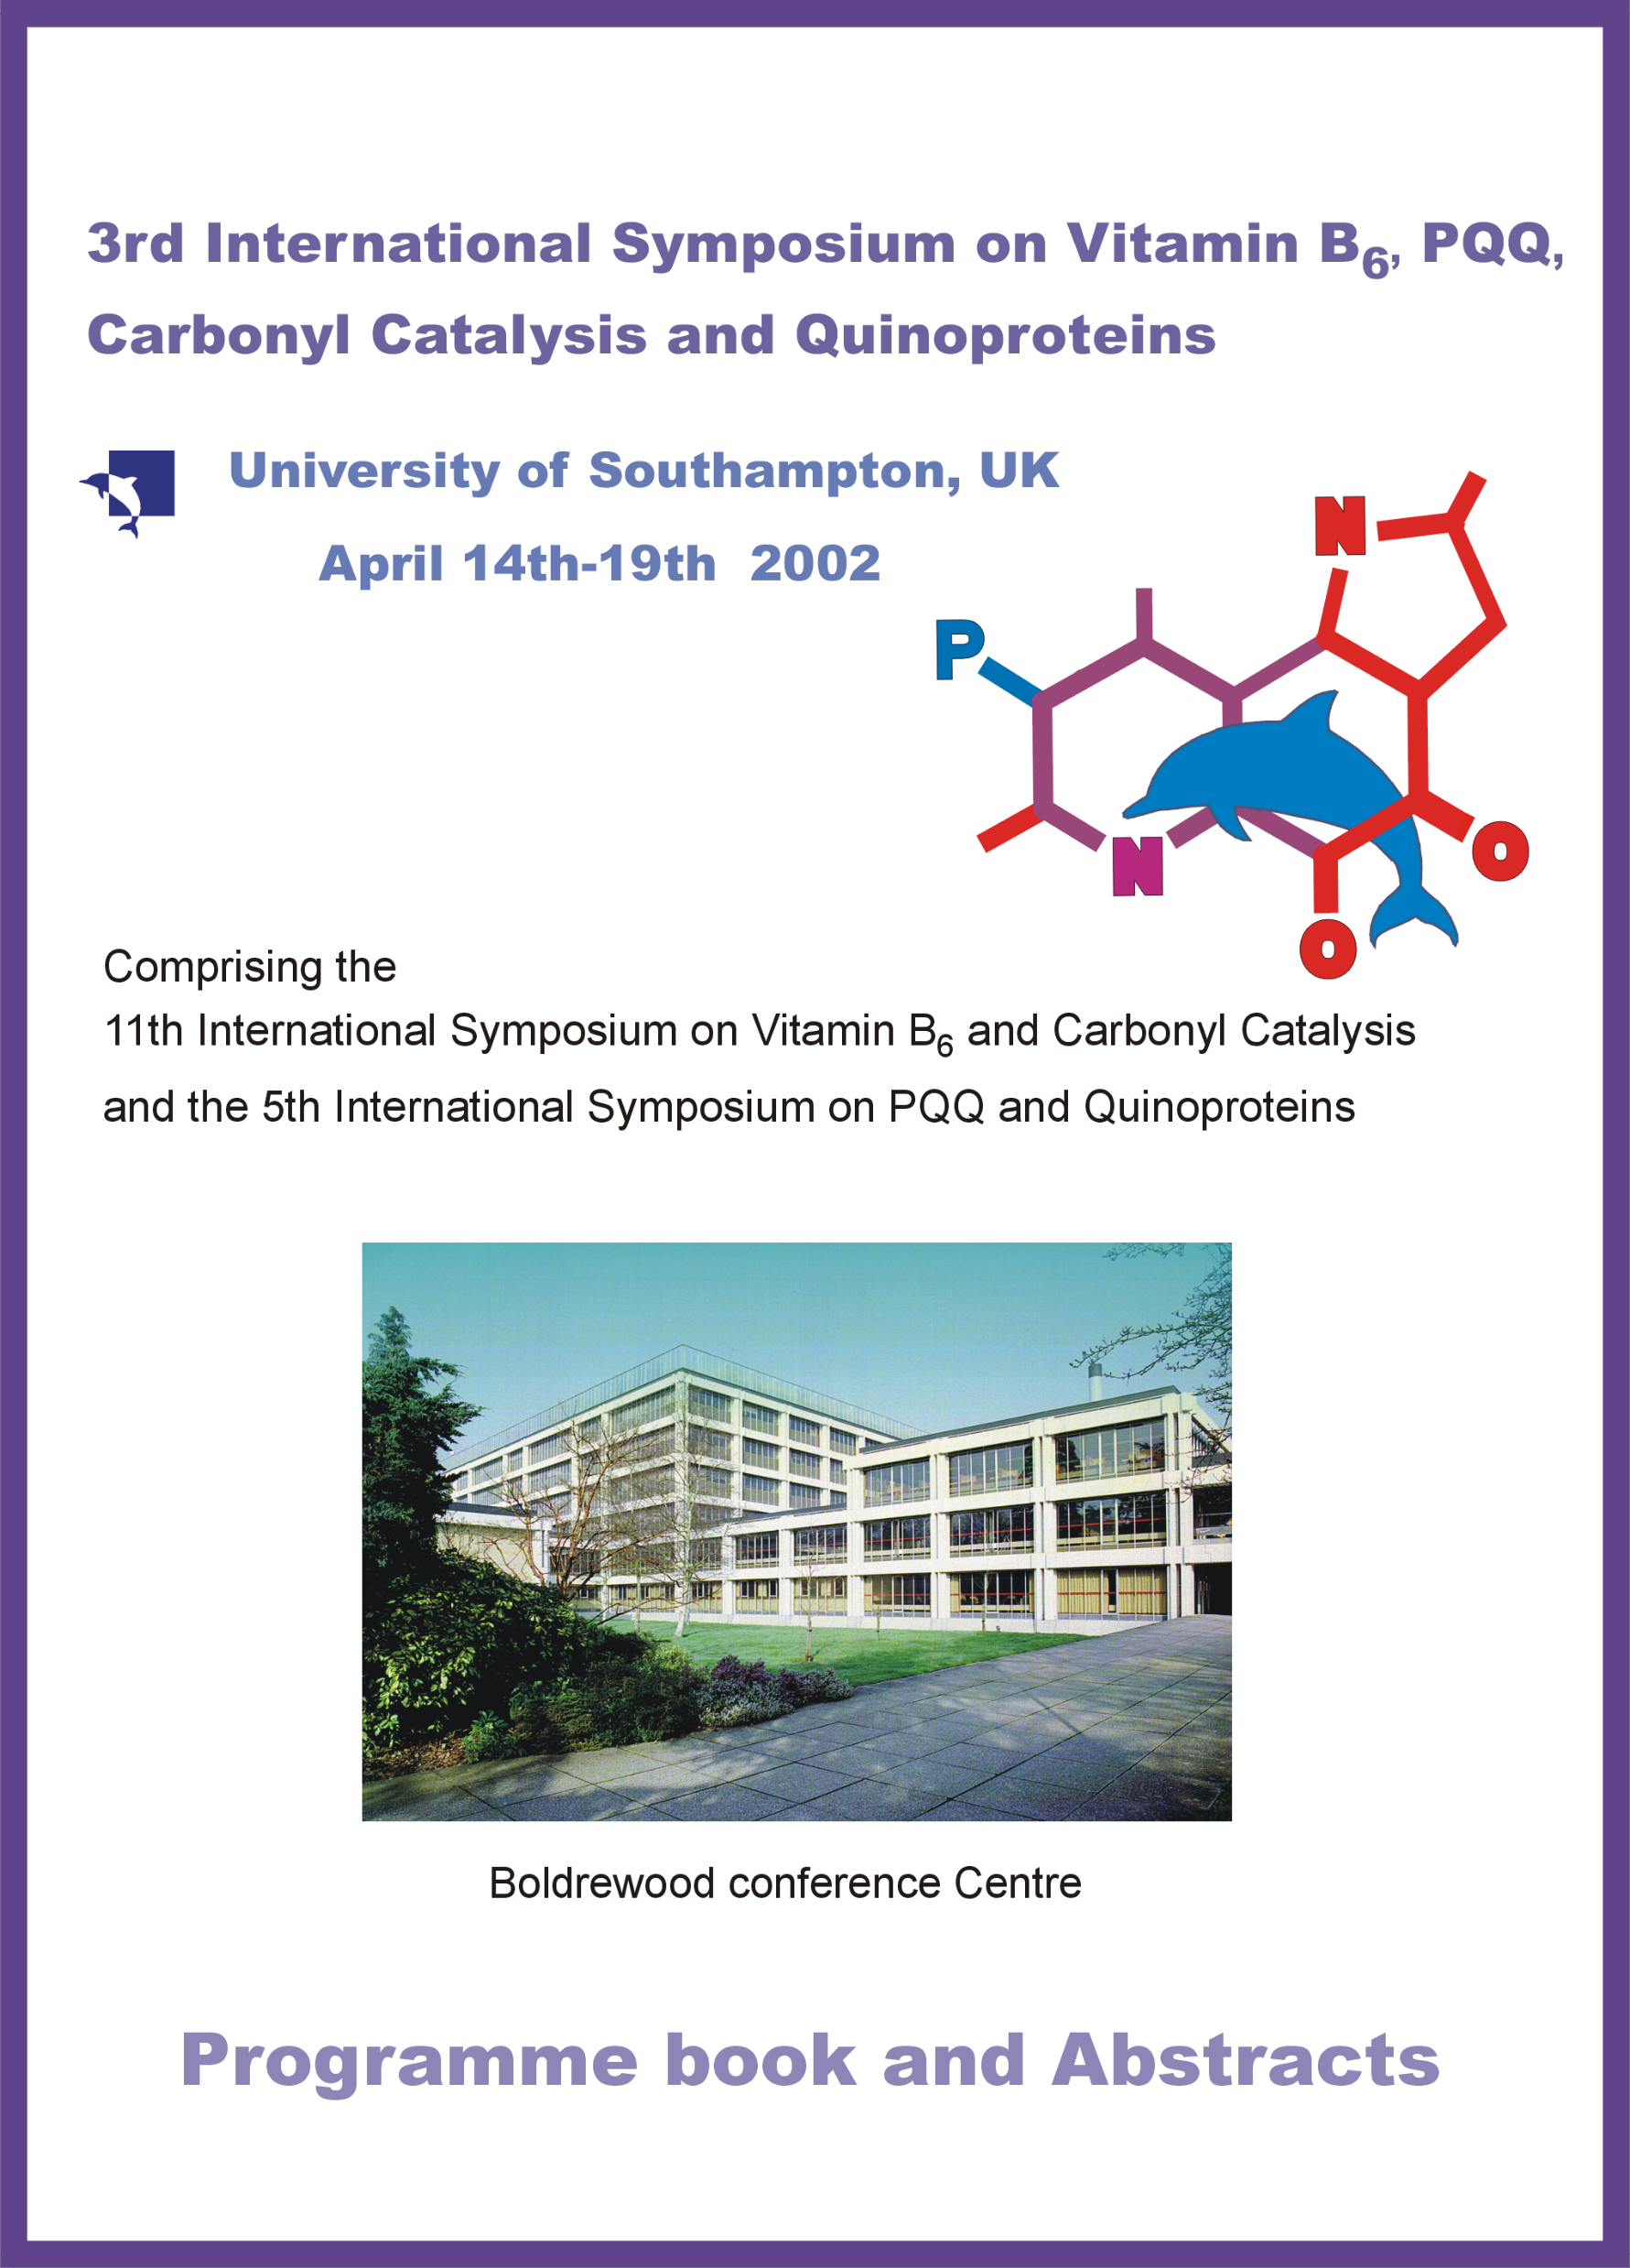

Slide 16
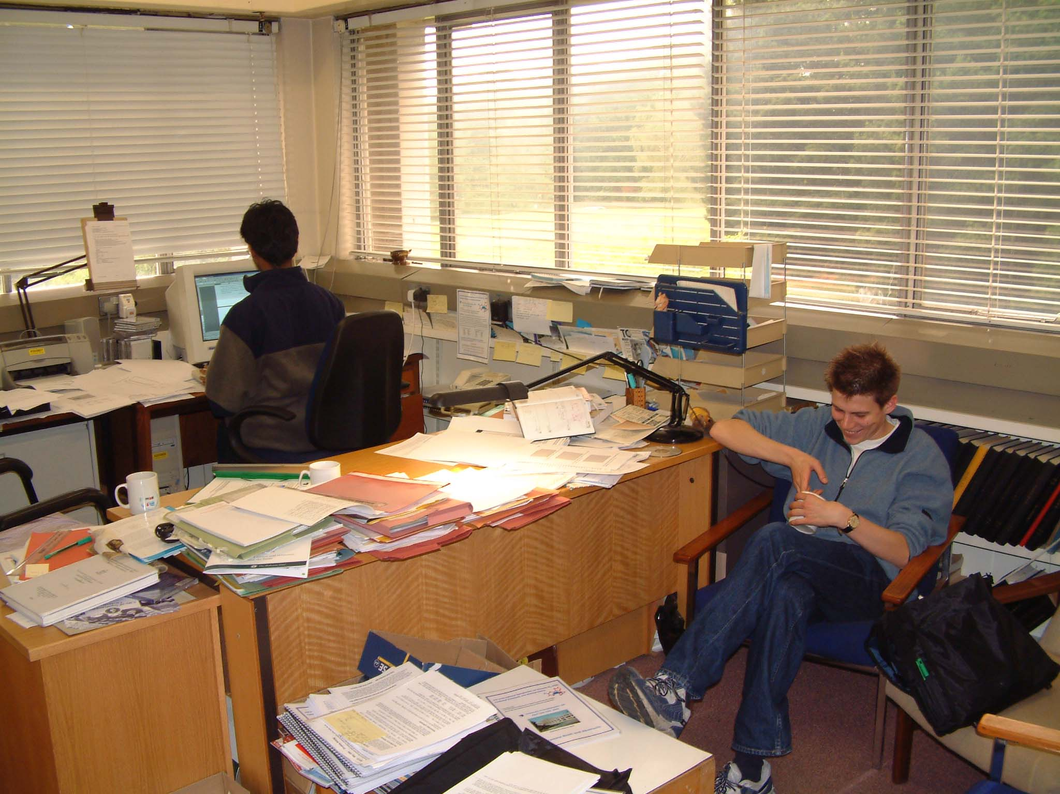
My office with Murali and Leigh

Slide 17
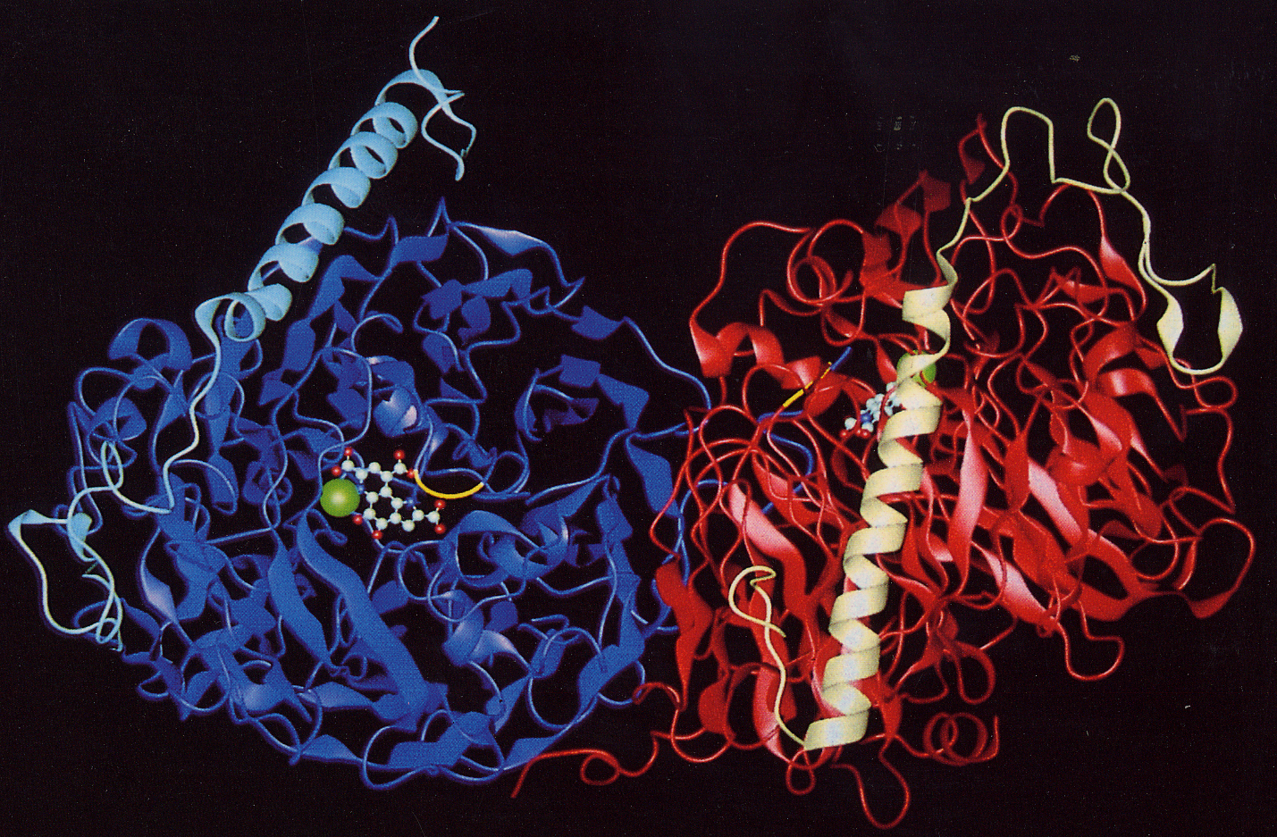
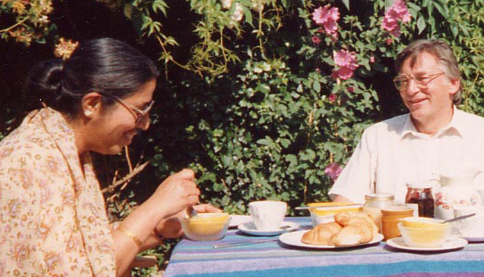
The X-ray structure
of MDH
The α2 ß2 tetramer
1992-2004
Southampton:
Chris Anthony
Alain Avezoux
Oxford:
Meenakshi Ghosh,
Colin Blake
MDH is a dimer
Large subunit is 60k
Small subunit is 9k
Meenakshi
Ghosh

Slide 18
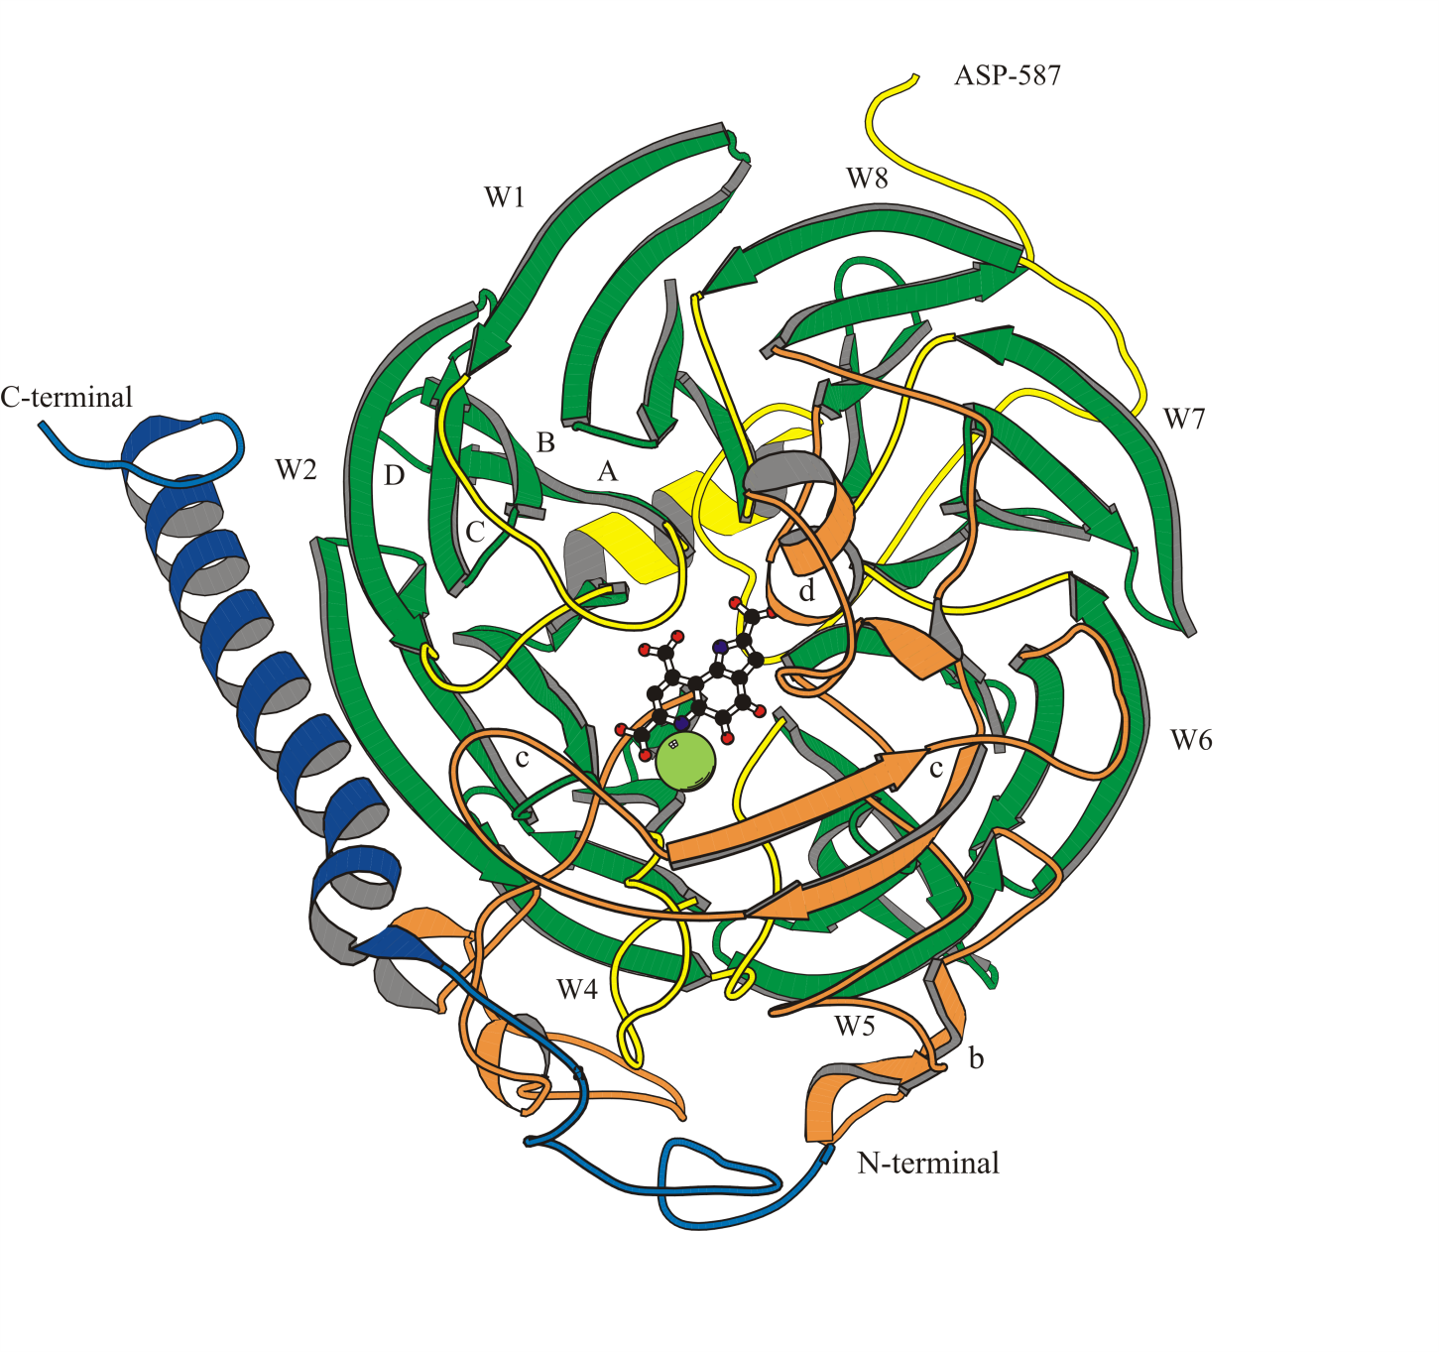
The ß-propeller structure of MDH
Eight 4-stranded ß sheets (W1-8);
these are ‘propeller blades’.
The ‘propeller fold’ forms a
superbarrel with active site inside
Active site contains PQQ
and calcium (green sphere)
The ß-sheet ‘propeller blades’ are held
together by ‘tryptophan-docking motifs’

Slide 19
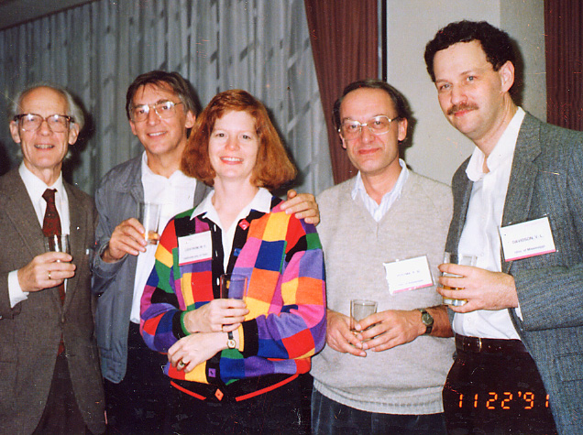
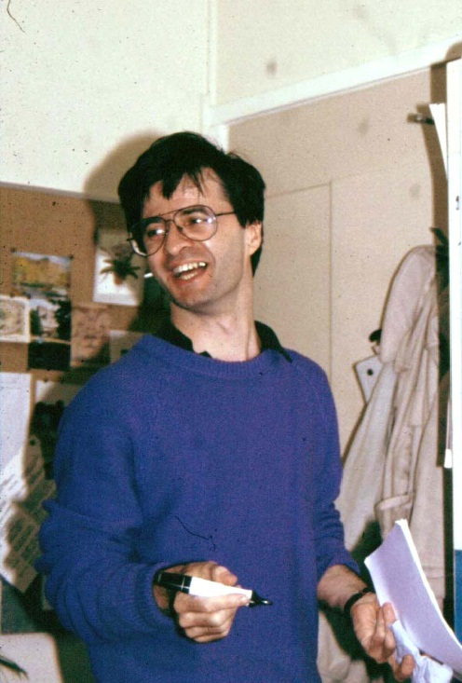

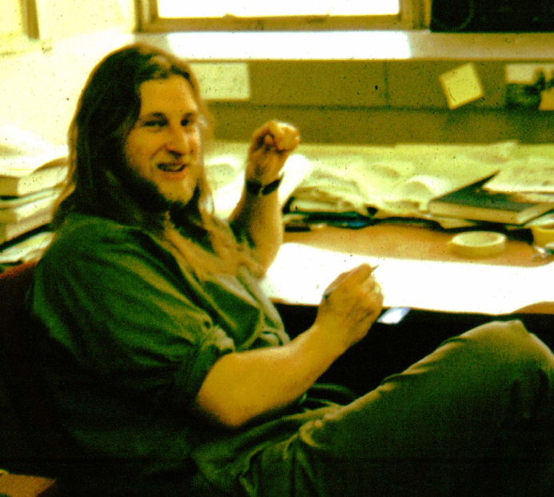
The calcium ion in MDH
1994 Kinetics of MDH containing
strontium [Harris & Victor Davidson]
Hauge
GDH
Peter
Postma
1996 Incubation with Barium produced MDH which was more active than
wild-type MDH [Matt Goodwin, Alain Avezoux & Simon Dales]
Mary
Victor
Alain
Matt
Simon

Slide 20
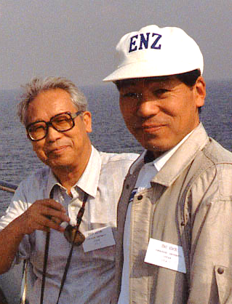

The calcium ion in MDH
1965-1989 ‘ MDH contains no metal ion’ [Anthony & Zatman]
1986 MDH from mutants (mxaA, K & L) was inactive and
had unusual spectrum [Nunn & Lidstrom]
1990 MDH contains Calcium (or strontium) [Adachi et al.]
1992 Other MDHs contain calcium.
MDH from mxaA, K & L lacked Calcium;
incubation with Ca produced active enzyme
& normal spectrum [Ian Richardson]
Ameyama
Adachi
1992 MDH isolated from marine Methylophaga
Marina is red and inactive;
incubation with Ca produced
normal green active enzyme [Claude Chan]
Ian
Claude
Jon

Slide 21
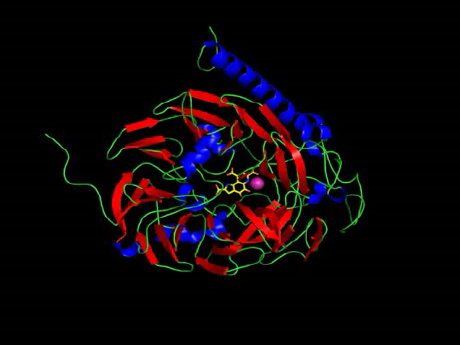

Slide 22
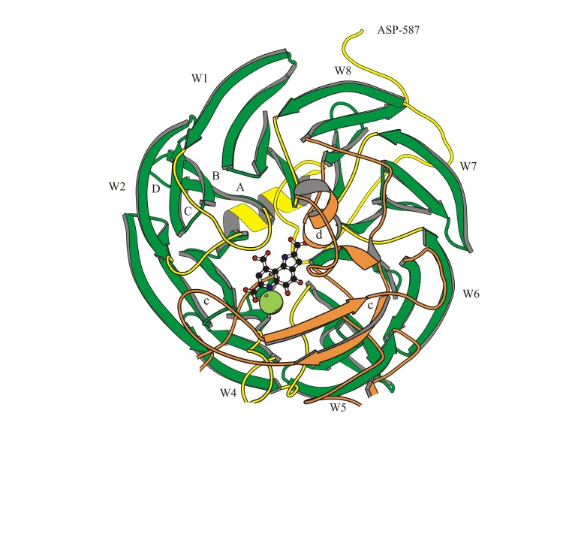
Tryptophan docking system
High proportion of tryptophans;
19 per α subunit
The ß-sheet ‘propeller blades’ are held
together by ‘tryptophan-docking motifs’

Slide 23
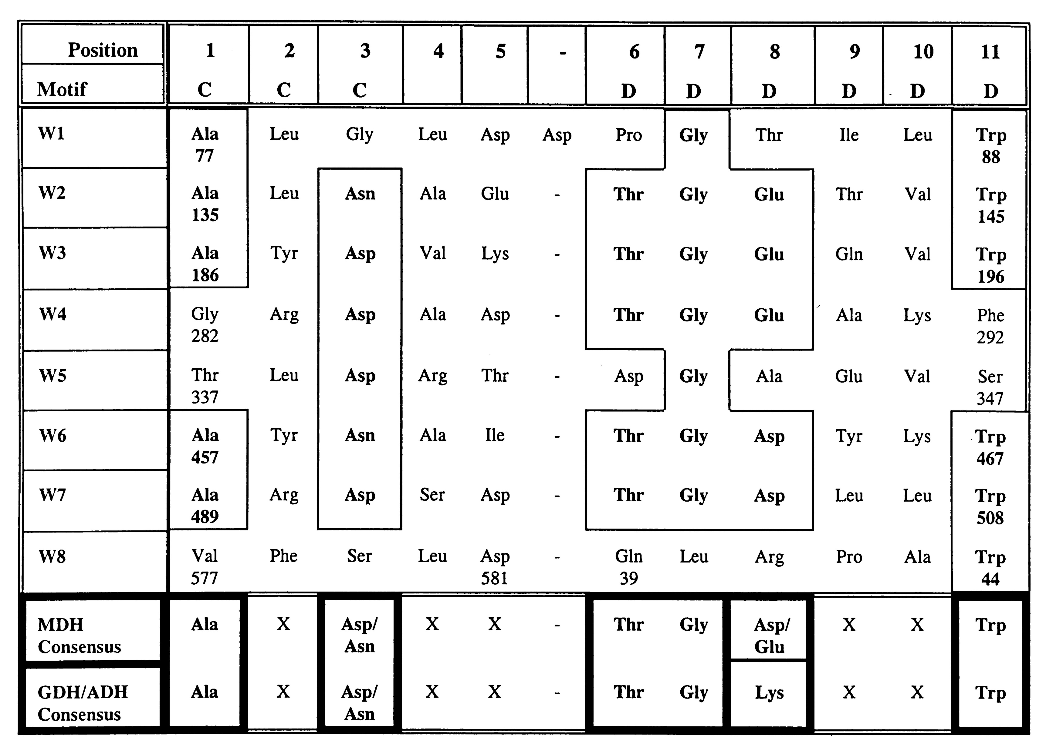
The consensus sequence in the tryptophan-docking motifs
Ala135
Trp145
Thr191-Gly192
Propeller blades W1-W8
For example: Trp145 of strand D in W2 is stacked between Ala135 in strand C in W2 and Thr-Gly at position 6-7 in W3

Slide 24
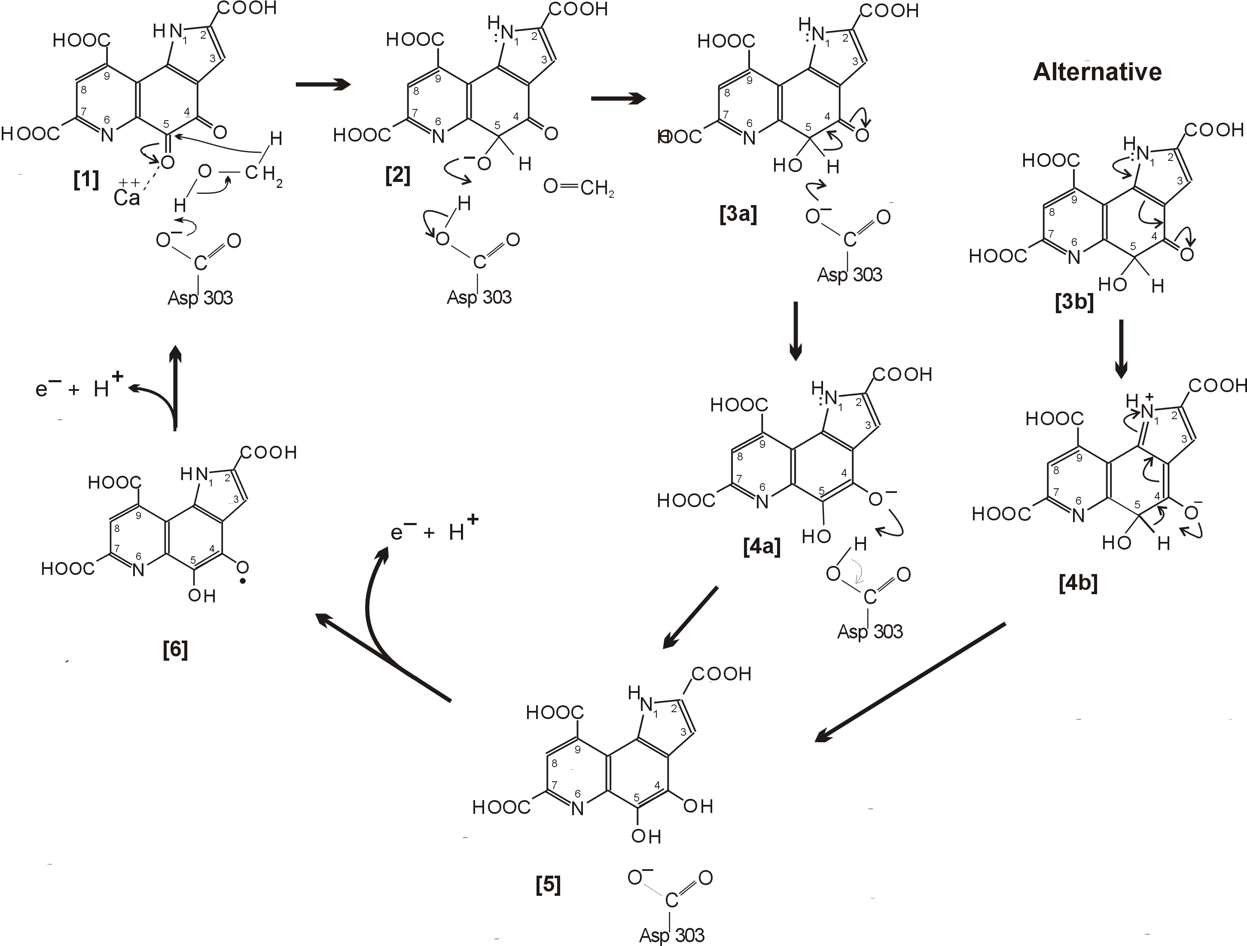
The Direct hydride transfer mechanism Anthony et al (1993--)
The quinol
Re-oxidation in two
single electron transfer
Steps.
Cytochrome c_{L} is the
electron acceptor

Slide 25
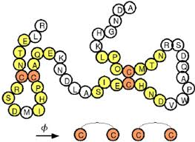
The unique disulphide ring structure in the MDH active site
Two distant Cysteine residues in proteins can be oxidised to form a disulphide bridge that is used to stabilise a particular conformation
Ramachandran stated that 2 adjacent cysteines would never form a bridge. BUT if they did then they would form an 8-membered ring structure with a ‘strained’ peptide bond.
None has ever been seen except in the active site of MDH.
It is very easily reduced, so breaking the bond and inactivating the enzyme.

Slide 26
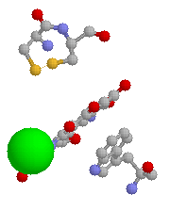
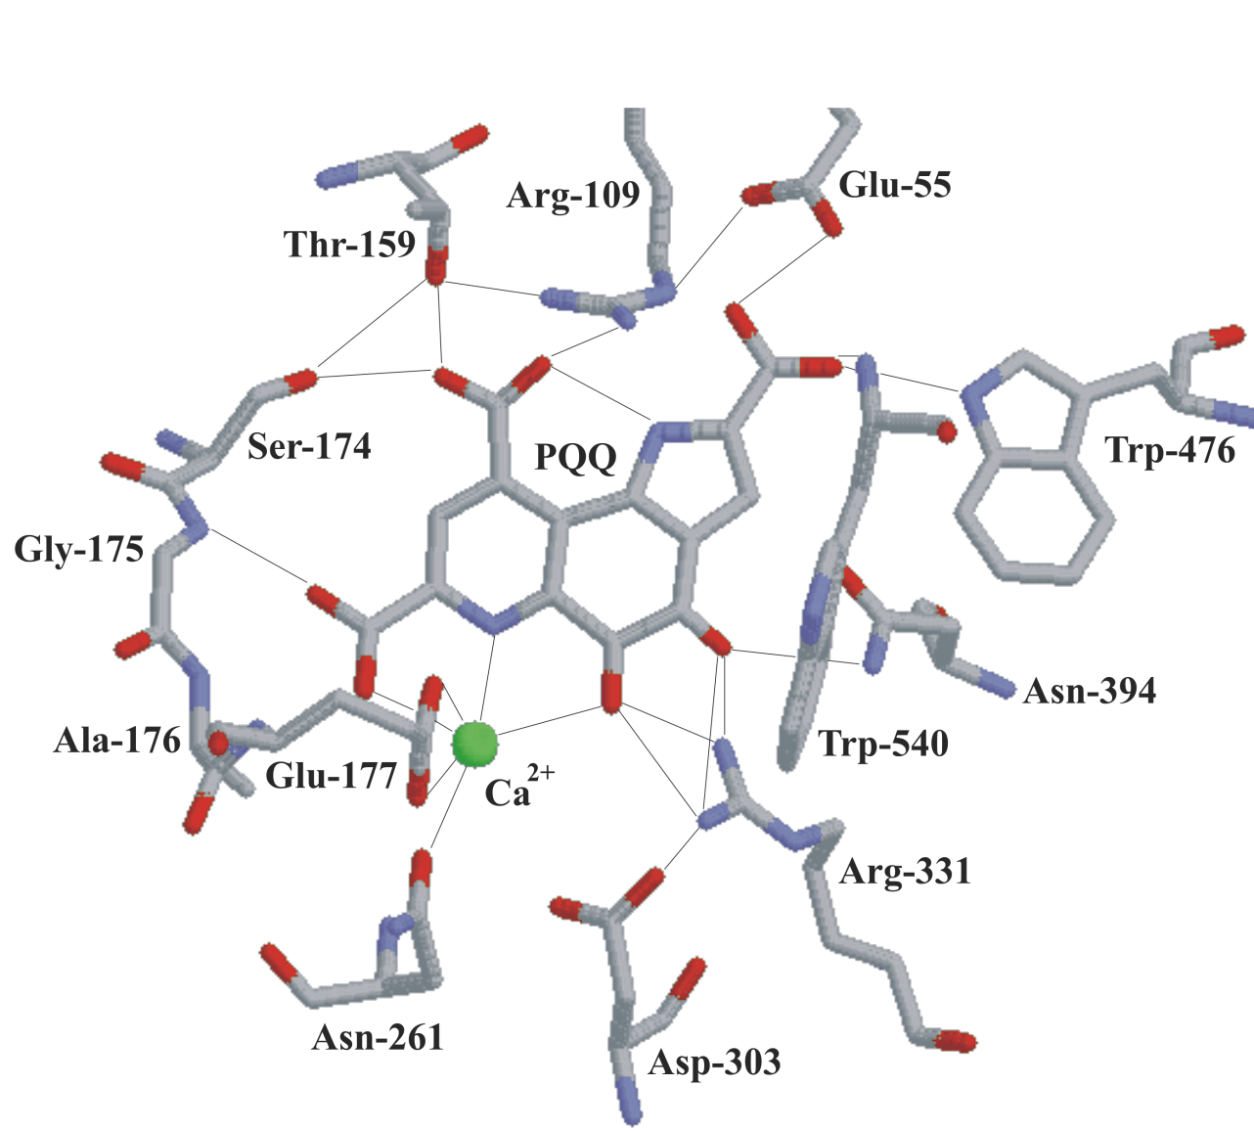
The active site of MDH
Ca
Novel disulphide ring structure
from adjacent cysteines

Slide 27
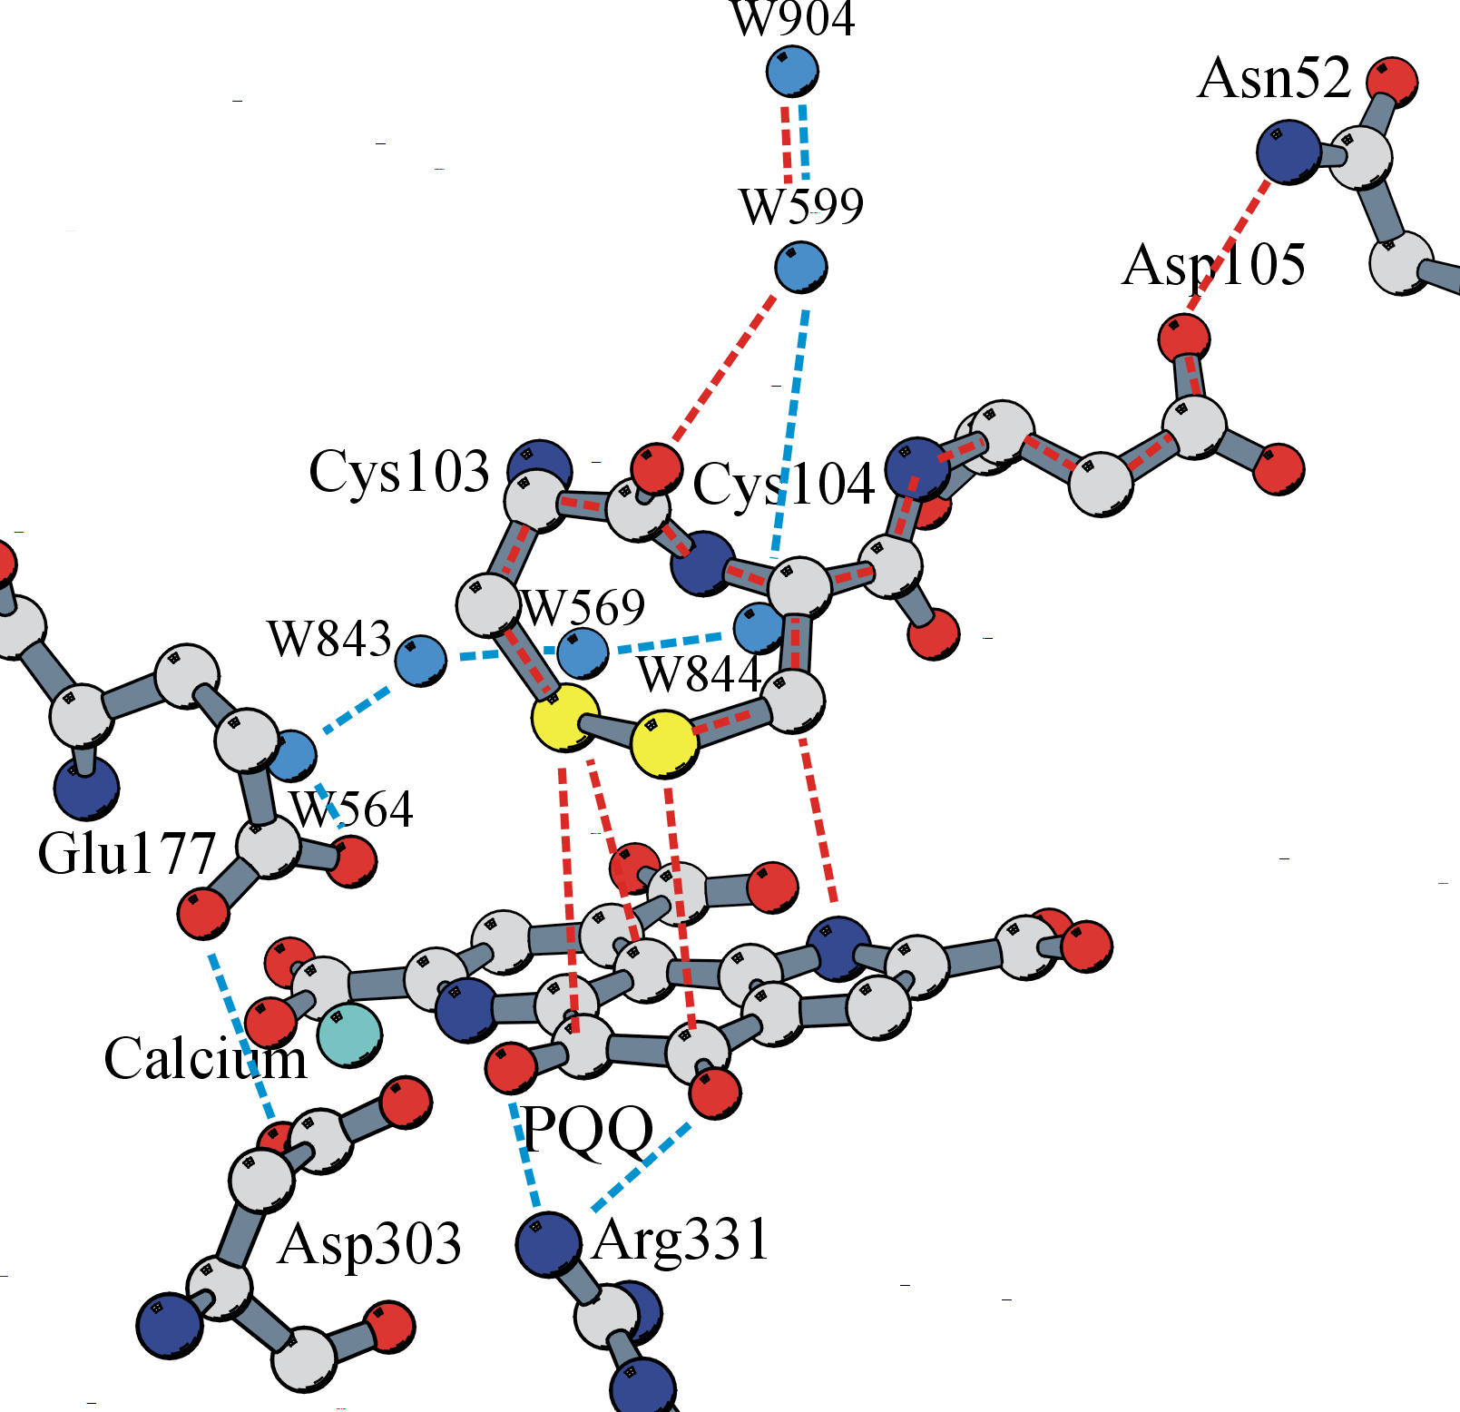
The path of electrons and protons during the oxidative part of the reaction mechanism of MDH
Electrons must pass from reduced PQQ (PQQH₂)
to a unique type of cytochrome - cytochrome c_{L}
Cytochrome c_{L}
Note involvement of the disulphide ring
Protons must pass from PQQH2
by way of its hydroxyls, and the
hydrogen-bonding network, to the water (W904)
which is accessible to the periplasm
The pathways are based on those
proposed for the quinohaemoprotein
alcohol dehydrogenase by Oubrie,
Dijkstra et al, and Chen, Matsushita,
Toyama, Scott Mathews et al.
MeOH

Slide 28
False claim that PQQ is vitamin
Most enzyme cofactors cannot be made in humans so have to be provided as their precursors – vitamins. Eg: NAD (Niacin), FAD (riboflavin)
If mammals do have quinoprotein enzymes then PQQ is almost certainly a vitamin.
In 2003 Kashara and Kato published a paper in Nature claiming to have found a gene coding for a quinoprotein and announcing that this meant that PQQ is “The first new vitamin for 55 years”.
This was welcomed with a great fanfare
Their argument was so obviously false so I ignored it.
BUT two years later Mitsubishi announced that they were investing 4 million dollars in producing this new vitamin. So I contacted them and published a paper in Nature explaining why it is not. But Mitsubishi went ahead and now it is on the market as a growth nutrient!

Slide 29
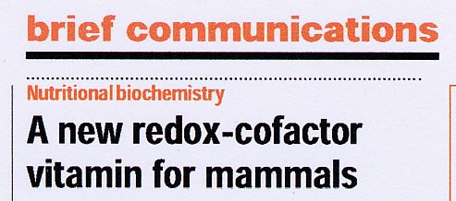
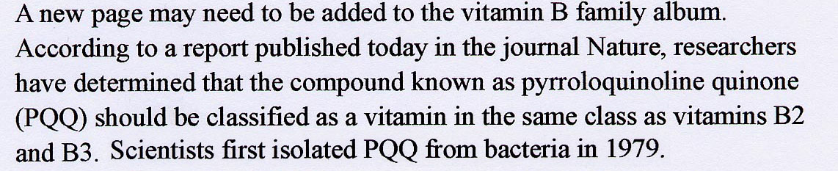
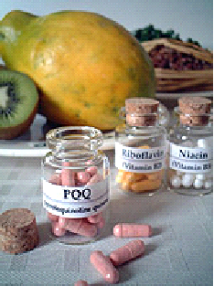
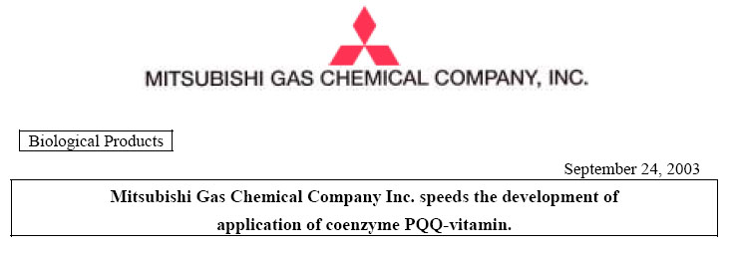
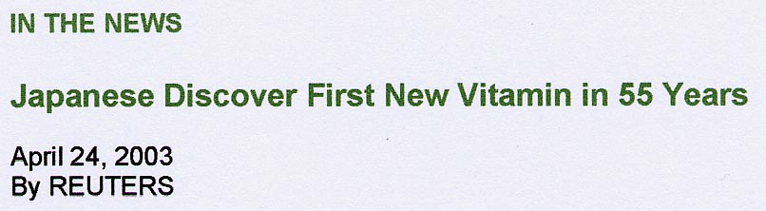
Premature announcement that PQQ is a vitamin for mammals
Takaoki Kasahara, Tadafumi Kato
Laboratory for Molecular Dynamics of Mental Disorders, Brain Science Institute, RIKEN, Japan

Slide 30

The argument by Kasahara and Kato
Search engines ‘identified’ PQQ-binding sites in a protein in mice [predicted from a gene sequence]
Our argument against
We cannot identify PQQ-binding sites in a database
In fact, the search engine found 7 ‘propeller blades’ that typically occur in PQQ-containing quinoproteins
The ‘propeller blades’ – wrongly identified by the search engine as ‘PQQ-binding sites’ are not directly involved in binding PQQ; they are purely structural
All trees are green All PQQ enzymes have propeller structures
My coat is green My protein has a propeller structure
SO: My coat is a tree SO: My protein is a PQQ enzyme
Therefore PQQ is a vitamin

Slide 31
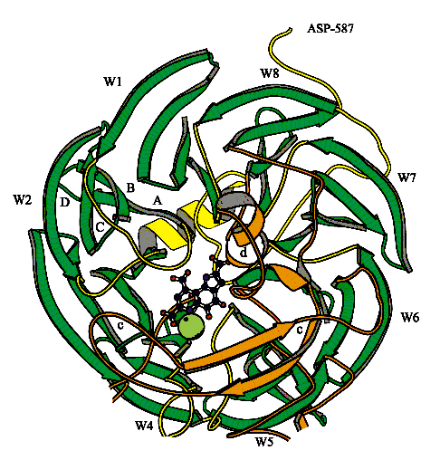

Premature announcement that
PQQ is a vitamin for mammals
Leigh M. Felton and Chris Anthony:
Nature; Communication Arising
The only evidence that the proposed dehydrogenase is PQQ-dependent is that the
Smart and Pfam databases ‘identified’ ‘7 PQQ-binding sites’ in the C-terminal region
In fact, the ‘sites’ are sequences predicted to form a series of ß-sheet ‘blades’
in a ‘propeller fold’ as seen in PQQ-dependent dehydrogenases.
This fold has nothing to do with PQQ binding and is found in many other proteins
The proposed enzyme has no sequence similarity to
any PQQ-dependent dehydrogenase
There is still no evidence that PQQ
Is a cofactor for a eukaryotic enzyme
Or that it is a vitamin
Thank you,
Goodbye and Good luck
Leigh

Slide 32


Slide 33
3rd Story: A special electron transport chain for methanol oxidation involves a novel type of cytochrome c
Methylobacterium has a ‘normal’ system for NADH and succinate oxidation
Inhibitors of NADH and succinate oxidation did not inhibit methanol oxidation
Inhibitors of the cytochrome oxidase did inhibit methanol oxidation
Addition of lactate (giving NADH) or succinate reduced cytochromes b, c and oxidase
BUT: Addition of methanol only reduced cytochromes c and oxidase
Methylobacterium and all methylotrophs have an extra cytochrome c called cytochrome c_{L} This is the specific electron acceptor for MDH. They react in the periplasm.
A student David O’Keefe boldly went against my advice, staying up most of the night and found it after months of my failure.

Slide 34

Electron transport during methanol oxidation
NADH
2H⁺ + ½ O₂
H₂O
NADH
dehydrogenase
Oxidase
Cyt bc₁
complex
UQ
HCHO
MDH
Cyt c_{L}
Cyt c_{H}
Periplasm
CH₃OH
2H⁺
Stuart Ferguson
Matt
Outer wall
During oxidation of MeOH 2 protons are released into the periplasm and consumed
Inside, setting up a protonmotive force supporting production of about 0.6 ATP/MeOH
1975 - 1985
David O’Keefe; Sandy Cross; Mathew Beardmore-Gray; Claude Chan;
Jon Cox; Darren Day; Steve Froud; Andy Elliott; Bill Keevil; Sasha Netrusov; Pat Goodwin

Slide 35
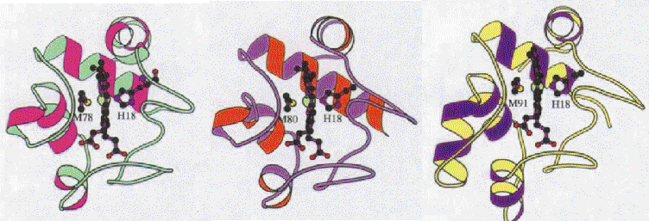
Structure of cytochrome c_{H}
M. extorquens
cytochrome c_{H}
Mammalian
cytochrome c
Bacterial
cytochrome c₂
Remarkably, cytochrome c_{H} is unique for a bacterial cytochrome in
being similar in structure to mammalian cytochrome c
Its internal structure ‘disproves’ a key proposal for cytochrome function:
All other cytochromes c have a tyrosine bonded to water in the haem cleft:
Cytochrome cH has tryptophan and no water. So the water has no function.

Slide 36
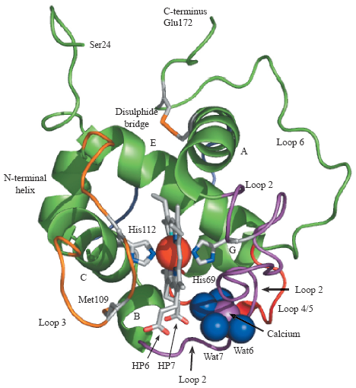
The X-ray structure of cytochrome c_{L}, the electron acceptor from methanol dehydrogenase Paul Williams and Southampton X-ray structure group
Paul Williams, Leighton Coates, Fiyaz Mohammed, Raj Gill Peter Erskine, Dominique Bourgeois, Steve P. Wood, Chris Anthony and Jonathan B. Cooper* (2006). The 1.6 A° X-ray Structure of the Unusual c-type Cytochrome, Cytochrome cL, from the Methylotrophic Bacterium Methylobacterium extorquens. J. Mol. Biol. 357, 151–162
The amino acid sequence is unique for cytochromes
The core structure is exactly as seen in other cytochromes c
Two cytochromes c have evolved in the same organism, functioning in the same electron transport chain, having similar core structure but no sequence identity
NOTE: the unique calcium ion and the exposed haem propionates

Slide 37
4. A resurgence of interest in MDH
In 1986 Mary Lidstrom and David Nunn published the methanol operon.
David came to work in my lab and he sequenced the genes for MDH and cytochrome c_{L}
A very remarkable observation
Mary Lidstrom showed that all methylotrophs have two methanol oxidation operons.
The 2nd (Mox2) is never expressed. Mutations in Mox2 do not affect growth on methanol.

Slide 38
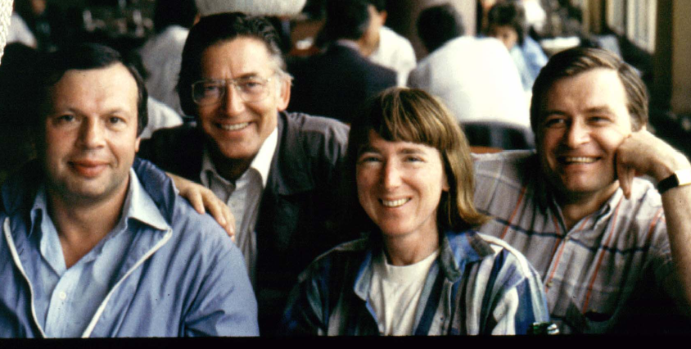
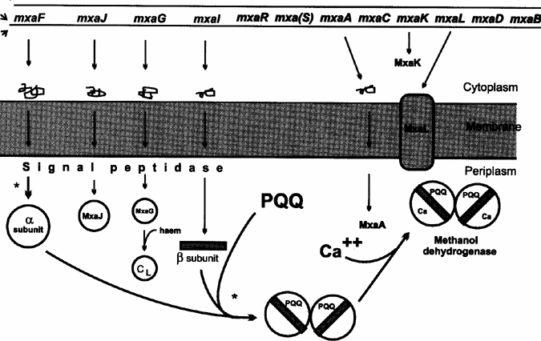
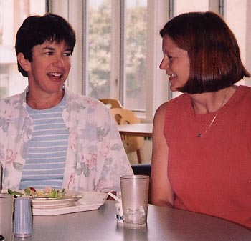
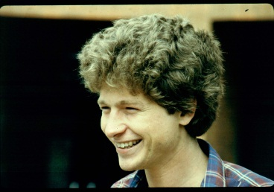

Expression of the mxa operon
Yuri
Sasha
Pat
MxaL
Mary
Karen
Amaratunga
The genes: Nunn, Lidstrom, Amaratunga, Anderson, Anthony, Goodwin, Morris, O’Connor

Slide 39
A novel methanotroph (Methanotrophs grow on methane which is oxidised to methanol which is then oxidised by MDH)
In 2017 a novel methanotroph (Methylacidiphilum fumariolicu ) was isolated from acidic volcanic mud. It grows at high temperature and low pH.
It requires a rare earth element for growth (eg Lanthanum, Cerium, Neodymium).
It only uses the 2nd methanol oxidation operon to produce MDH which uses one of the lanthanides instead of calcium at the active site. As a result during the last few years I have weekly reports on ResearchGate of my 1964 paper being cited!
A final strange thing
In 2018 Colin Murrell’s group at UEA described a novel methylotroph isolated from seawater using a methanol medium containing lanthanum salts.
“We propose the name Marinibacterium anthonyii (in honour of the British microbiologist Professor Christopher Anthony)”. Note: I was Colin Murrell’s tutor here and he played second violin in my string quartet.
Marinibacterium anthonyii is the only methylotroph that does not have ‘my’ MDH); it only has the 2nd methanol oxidation operon.

Slide 40
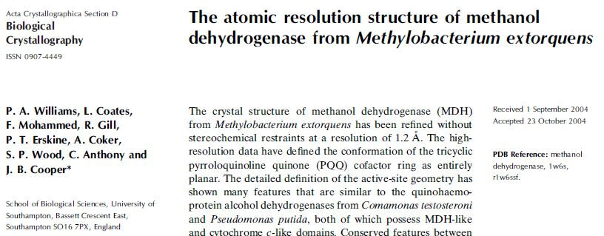
Our last publication on MDH 40 years after my first

Slide 41



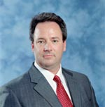

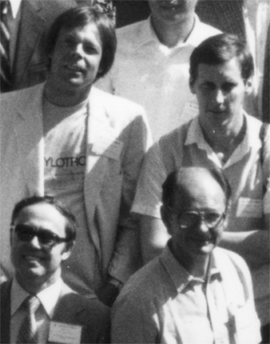

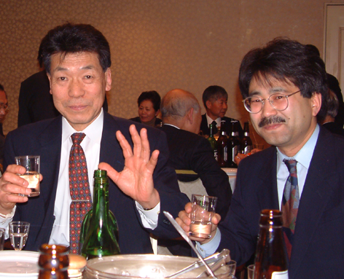

Acknowledgements
Len Zatman & Pat Goodwin
Claude Chan
Kevin Auton
Darren Day
Matt
Beardmore-Gray
H. Dalton
Paul Skipp
Hiro
Toyama
Wolfgang Babel
Sasha
Netrusov
Karen
Amaratunga
Yuri
Pat

Slide 42






Acknowledgements
David Nunn
Ian
Richardson
Claude
Chan
Alain
Avezoux
Ashley Lawton
President, Phylos Inc.
Jon Cox
Ian Richardson
Tony Long
Matt Goodwin
Simon Dales
Leigh Felton

Slide 43

For extensive discussion of all the material in this seminar go to my website: chris-anthony.co.uk

Slide 44
A few more pictures of methylotroph friends

Slide 45




A BioCellist
Chris
1959
Colin Murrell
2nd fiddle
1977
Colin grown up

Slide 46




More friends
Kondratieva
Paul Skipp
Hiro
Toyama

Slide 47




PQQ and other quinoproteins The novel prosthetic group of MDH was later in other dehydrogenases and Hans Duine and Hans Frank called these Quinoproteins. These include the alcohol dehydrogenase of acetic acid bacteria and the typical glucose dehydrogenase in Pseudomonas, E. coli.
Hauge described GDH and PQQ very early on
Friends from Yamaguchi, Japan:
Matsushita, Uragami (?), Ameyama, Adachi.
Found many new quinoproteins especially in Acetic acid bacteria
Note: No PQQ-containing quinoproteins have been described in anything other than bactera
Hans Duine and Hans Frank
‘invented’ quinoproteins

